Slide 1

Welcome to Marketing Research MKTG2341 Tom Jopling
w
E
E
K

Slide 2
Let me Introduce myself …

Slide 3

Tom Jopling
20+ years experience in marketing and marketing research. Current positions:
Bridge Research – Principal
Brandlab Studios – Research Director

Slide 4


Tom Jopling
Instructor in Marketing Management - BCIT and UBC

Slide 5
Industry Experience:
new product/service development
corporate/organizational branding
advertising/communications testing and tracking
needs assessments
awareness and perception
public opinion polling
customer/employee satisfaction
policy analysis
training and development

Slide 6
Clients:
Big companies/organizations
Grey Worldwide, BC Hydro, ICBC, TD Bank
Small companies/organizations
7 Seas Seafood, North Island College, Sunrise Tofu
Government
Governments of Canada, BC and many municipal
Not-for-Profit
CNIB, Heart and Stroke Foundation, Alzheimer’s Society

Slide 7
Education:
M.A., University of Toronto
B.A. (Honours), University of Alberta
Dip. Sales and Marketing Management, University of British Columbia

Slide 8
Other:
Certified Marketing Research Professional
Certified Marketing Executive
Certified Sales Executive

Slide 9
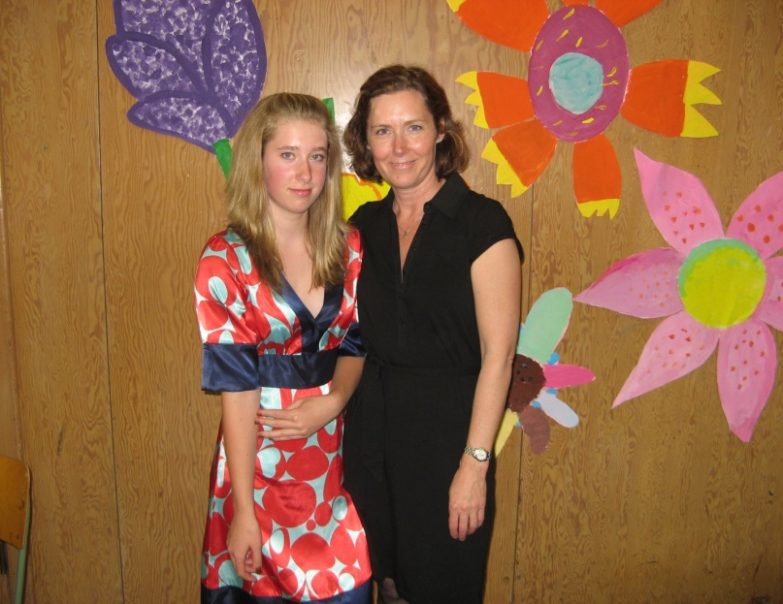





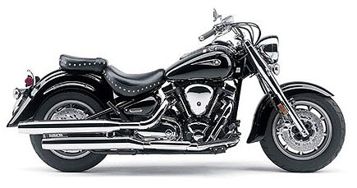
Life outside of work…
Family
Home renovations
Motorcycling
Mountain biking
Skiing
Cooking
Wine!

Slide 10
Office Hours
Office: SE6-304
Office Hours
Mondays: 10:30 to 11:20am
Tuesdays: 10:30-11:20am and 2:30 to 3:20pm
Wednesdays: 9:30 – 10:20am
Thursdays: 11:30 – 12:20pm and 1:30-2:20pm
Note: I am not on campus on Fridays

Slide 11
MKTG2341 Marketing Research
Course Introduction:
Course Outline & Structure
Course Expectations
Text Book
Group Project

Slide 12
Course Outline & Structure
Course Outline:
Available on: http://www.bcit.ca/study/outlines/index.shtml
Course Structure:
2-hour Lectures theories & concepts
Labs application of the concepts:
1-hour PC Lab
1-hour Classroom Lab
Notes:
Tom –
Please add your own outline changes if you want to announce them.

Slide 13
Course Expectations
Attendance:
Attendance in Labs and Lectures.
Remember to sign attendance sheet at lectures.
Max 10% absence policy.
If you are absent email me and your group.
Lecture Slides:
Posted on Share-out with blanks … take notes.

Slide 14

Textbook
Solid foundation in Marketing Research.
Up-to-date, latest trends in research.
Practical approach.
Key feature: XL Data Analyst
Excel macros.
Notes:
Stress that they NEED the text!

Slide 15
Group Project
30% of the grade
Runs through out the semester.
Project Guidelines handout:
Pick up a copy on your way out today.
Like a manual – refer to it before each major stage in the research process.

Slide 16
Group Project
Groups of 4-5
Choose a consumer product or service.
Involves 3 types of research:
Secondary Research (industry overview, trends, competitors, company profile, etc).
Qualitative Research (Focus Groups w/ consumers, In-depth Interviews w/ experts).
Quantitative Research (Survey).

Slide 17
Example of Project Topics
Brand Awareness & Perception:
Consumer brands, sports merchandise, tourist attractions, non-profit society/charity.
Communication Effectiveness:
Assessing effectiveness of flyer in exit-survey at retail location.
Measure advertising recall and/or recognition.
Customer Satisfaction:
Measure customer satisfaction for a sales organization, restaurant, hotel, tourist attraction, property management company, etc.

Slide 18
New Product/Market Opportunity:
Customer receptiveness to a new line of merchandise.
Assess new market segments for current products.
Market feasibility studies for new service concepts for local tourist or recreation providers (e.g., IMAX).
Work with a local municipal tourism departments (e.g., Tourism Richmond) to assess new market opportunity.
Market feedback on a proposed condo development.
Market needs assessment for a development company (i.e., what do potential buyers want, what are they willing to pay for)
Work with a local planning department, gather community feedback on proposed zoning changes.

Slide 19
Learning Objectives
To identify the uses of Marketing Research.
To explain the sequence of steps of the marketing research process.
To explain why secondary research is conducted first.
To use search engines effectively.

Slide 20

Why Do Market Research?
Powerful Business Tool
Businesses need quality information to make sound decisions.
Even in recession research is needed:
eMarketer Digital Intelligence: “Why now is not a good time to slash your market research budget”.
MasterCard using research during uncertain economic times to identify new growth opportunity.
Notes:
Why Now Is Not a Good Time to Slash Your Market Research Budget
MasterCard is using research during uncertain economic times: As cited in the March 23 issue of BusinessWeek, MasterCard learned from market research that certain consumer technology adoption trends were occurring in emerging countries, and these were creating new and exciting growth opportunities for the industry—and for MasterCard in particular.
eMarketer Digital Intelligence article:
With the economy clouding the future, why throw away your flashlight when it could shine on intriguing consumer insights, hot technology trends and market opportunities?
Market research can help you preserve budgets, projects and even people. Market research data and insights—when used properly—can grease the wheels of corporate acceptance for proposals, presentations, recommendations, new business pitches and even entire marketing budgets.
Prepare for better times ahead.
Source: http://www.emarketer.com/Article.aspx?R=1007001

Slide 21
Why Do Market Research?
More important than ever…
Need to minimize risk, make better decisions.
Competition is fierce & consumers are demanding.
Changing consumer preferences.
Media & consumer fragmentation.
Increased pressure to generate more revenue and profit.
That which gets measured, gets managed

Slide 22
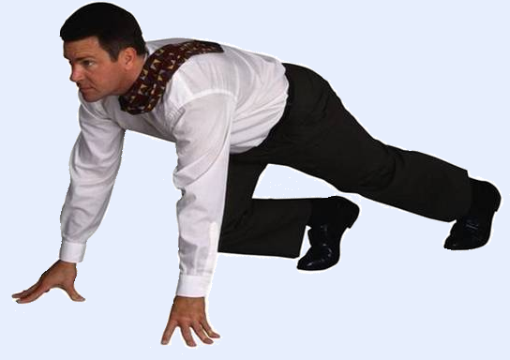
Why Do Market Research?
Start-up Phase
Research can jumpstart your new business.
Identify key elements of your business and marketing plan.
Identify your target audience.
Study market characteristics.
Select the best location for your business.

Slide 23

Why Do Market Research?
Expansion Phase
Track customers’ changing needs.
Measure advertising efficiency.
Identify new markets and new opportunities.
Monitor developments and trends in your industry.
Notes:
Describe a situation where a lack of market research has incurred significant cost. A classic example is the product development & launch of “New Coke”
What business you want to be in – what industry, what sector, what kind of business?
Marketing plan – 4 Ps: what product/service will you market, at which price, how are you going to get your product to the customers (Place=distribution), how can you best communicate with your customers etc.
Market

Slide 24
Why Do Market Research?
Student Benefits:
Assignments & Term Projects.
In January you all need research:
Promotional Strategies Comm students
DS project all other sets
Add the skill to your resume
A+ Success Story

Slide 25
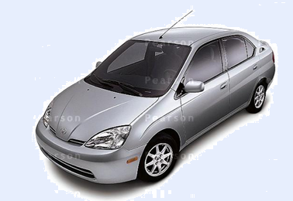
We need Marketing Research to:
Make the “right” marketing decisions:
Practice the marketing concept.
Make the right decisions to select the right marketing strategy.
Example:
Toyota’s Prius strategy targeted the “fuel economy” segment of the auto market.
Their “mix” fulfills wants & needs with their hybrid auto.

Slide 26
What are the Uses of
Marketing Research?
Identify marketing opportunities and problems.
Generate, refine, and evaluate potential marketing actions.
Monitor marketing performance.
Improve marketing as a process.
Notes:
Identifying marketing opportunities and problems
Market-demand determination
Market segments identification
Marketing audits SWOT analysis
Problem: Does our advertising work?
Generating, refining, and evaluating potential marketing actions
Proposed marketing-mix evaluation testing
New-product prototype testing
Advertising pre-testing
Monitoring marketing performance
Image analysis, i.e. bank image analysis
Tracking studies, i.e. sales, market shares of all brands in our category
Customer satisfaction studies
Improving marketing as a process
The purpose of these studies is to expand knowledge (Basic research) of marketing as a process rather than to solve a specific problem (Applied research) facing a company.

Slide 27
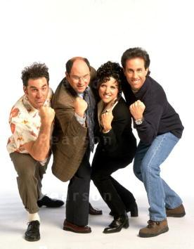
Sometimes Marketing Research is Wrong!
Marketing research has predicted success when products failed.
Marketing research has predicted failure when products were a success!
Notes:
Seinfeld was predicted to be a failure …

Slide 28
The Marketing Research 11 Step Process
Establish the need for marketing research
Define the problem
Establish research objectives
Determine research design
Identify information types and sources
Determine methods of accessing data

Slide 29
The Marketing Research 11 Step Process …
Design data collection forms
Determine sample plan and size
Collect data
Analyze data
Prepare and present the final research report

Slide 30
Research Process & the Text
1) Establish Need
2) Define Problem
3) Research Objectives
4) Determine Design
5) Identify Information Sources
6) Decide Data Collection Method
7) Design Questionnaire
8) Determine Sample Plan & Size
9) Collect Data
10) Analyze Data
11) Write and Present Report
Figure out what to research; Ch3
Design the way to do research; Chapters 4-10
Gather data; Chapter 11
Analyze and report findings; Ch 11-15

Slide 31
Caveats to a Step-by-Step Process
It is very important to know the steps; but:
There is no magic to it being 11 steps.
Not all studies require all 11 steps.
Many studies do not follow the steps in exact order.

Slide 32
Step 1: Establish the Need for Marketing Research
Is there a real need for marketing research?
Research takes time and costs money.
Sometimes you should NOT conduct research.

Slide 33
When is Marketing Research Not Needed?
Costs outweigh the value of research.
Online research – fast and cheap.
The information is already available.
The timing is wrong … must make decision now!

Slide 34
To Research or Not to Research… That’s the Question
Profit Margin
Small Profit Margin
Large Profit Margin
Small
Market
Size
Cost likely to be greater than benefit;
Ex eyeglasses replacement screw
Possible benefits greater than cost;
Ex ultra expensive sportswear
Market Size
Large
Market
Size
Benefits likely to be greater than costs;
Ex Stouffers frozen dinner
Benefits likely to be greater than costs;
Ex medical equipment
Potential value of a Marketing Research should exceed its estimated costs.

Slide 35
Step 2: Define the Problem
This is the most important of the 11 steps. (NEXT WEEK’S LECTURE)
If the problem is incorrectly defined, all else is wasted effort.
Problems may be either specific or general.

Slide 36
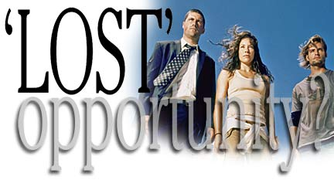
Step 2: Define the Problem
Problems stem from:
Gaps between what is supposed to happen and what did happen.
Gaps between what did happen and what could be happening.
Notes:
Gaps between what is supposed to happen and what did happen.
Ex: Sales decreasing, ROI below target
Gaps between what did happen and what could be happening.
Increase sales if adding new product feature
Increase profit if expanding into new growing territory

Slide 37

Step 2: Define the Problem
What examples can you think of for:
Q1: Gaps between what is supposed to happen and what did happen.
A1:
Q2: Gaps between what did happen and what could be happening.
A2:

Slide 38
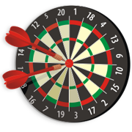
Step 3: Establish Objectives
Specifies the information needed to solve the problem (step 2).
Must be specific and measurable.
Must include from whom you will collect the information.
Critical to get it just right

Slide 39
Step 4: Determine Research Design
Exploratory
Used when one is seeking insights into the issues.
Descriptive
Used to provide an accurate snapshot of the market environment.
Causal (experiments)
Used to uncover cause & effect.
Notes:
1. Exploratory
Used when one is seeking insights into:
The general nature of a problem.
The possible decision alternatives.
The relevant variables.
2. Descriptive
Used to provide an accurate snapshot of some aspect of the market environment.
3. Causal (experiments)
Used to uncover what factor(s) cause some event by isolating cause & effect.

Slide 40
Step 5: Identify Information Types & Sources
Secondary Data:
Information already collected
Primary Data:
Information collected specifically for the problem at hand.

Slide 41
Step 6: Methods of Accessing Data
Secondary data is easy to access.
Generally cheaper.
Can be time-consuming.
We’ll cover this the first 3 weeks.
Primary data is more complex.
Person ask questions.
Computer assisted or direct questions.
Respondents to answer themselves (without computer assistance).
Combination.

Slide 42
Step 7: Design Data Collection Forms
Questionnaire: We communicate with respondents.
Meet the research objectives
Clear & without bias
Minimize refusal rates
Observation forms: We observe subjects’ behaviour.

Slide 43
Step 8: Sample Plan and Size
Sample Plan:
Describes how each sample element, is drawn from the total population.
Determines if the sample is representative of the population.
Sample Size:
Determines how accurately the sample results reflect the values of the population.
Sample Error:
Error in the data because a sample was used.

Slide 44

Step 9: Collect Data
Quality control during Data Collection is very important.
Data Analysis cannot fix bad data.
“Garbage in - - Garbage out”

Slide 45
Step 9: Collect Data
Non-sampling errors may occur during data collection.
Errors caused by field workers or respondents.
To minimize the errors you must know the sources.

Slide 46
Step 10: Analyze Data
Data Base: Data must be transferred from the collection forms to database.
Data Cleaning: inspecting for errors.
Data Analysis: running tabulations and statistical tests.

Slide 47

Step 10: Analyze Data
XL Data Analyst is a set of software tools that you will use to learn how to analyze data.
XL Data Analyst uses Microsoft Excel & requires version 2003 or higher.
Not MAC compatible

Slide 48
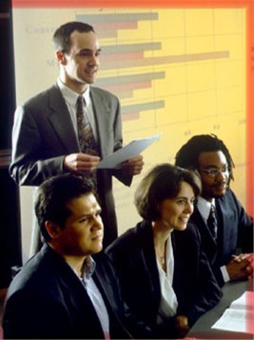
Step 11: Prepare and Present the Final Research Report
Typically there is a written report and an oral presentation to the client.
Often the report is the only record of the research project for the client.

Slide 49
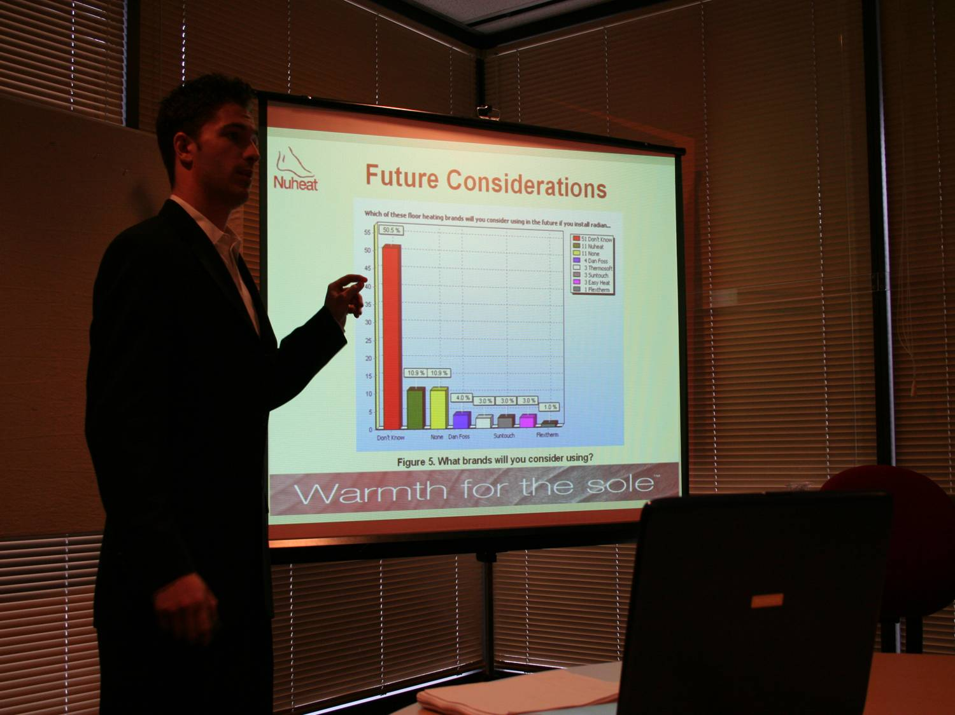
A winning Presentation
Notes:
A brief talk about MRIA competition…

Slide 50
MOVING ON TO THE NEXT TOPIC …
You have just learned about the
Research Process
Next, let’s look at:
On-line Secondary Research
But first …

Slide 51
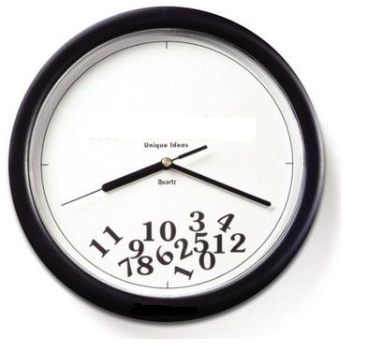
A break …
10 min

Slide 52
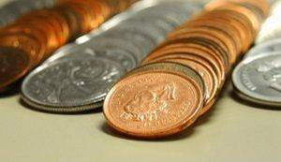
Do
Secondary Research
FIRST
Do
Primary Research
NEXT

Slide 53
Are you information literate?

Slide 54
Information Literacy
Anyone who wants to do research activity must possess 4 Key Abilities:
Articulate an information need.
Locate relevant information sources.
Evaluate the quality of those sources.
Communicate the results.
Notes:
Some people confuse “Computer Literacy” with “Information Literacy”. These are NOT the same! Computer literacy can be thought of as One Element in the total package of Information Literacy.

Slide 55
Identify
main concepts
2
3
Construct Search Strategies
Define the Research Topic & Objective
and (+)
or (,)
not (-)
1
*
Know the tools to find info
Research Skills Cycle
Evaluate the information
4
7
Find various sources of info
Improve search and refine
5
6
Notes:
Text has three main steps (pp 15—153 ):
Identify what you wish to know and what you already know about the topic. (Steps 1 & 2 in above slide)
Develop a list of key terms and names. (Steps 2-3 above)
Begin your search using several library sources. (Steps 4-7 above)

Slide 56
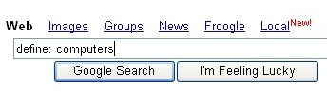
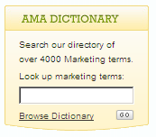
Dictionaries … to find meaning of words
Google define: followed by the word.
Dictionary.com http://dictionary.reference.com/
Merriam-Webster Online http://www.m-w.com/home.htm
AMA Resources & Dictionary www.marketingpower.com

Slide 57
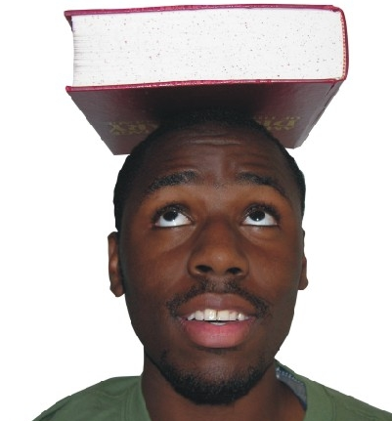
Encyclopedias … to find overview of a topic
Wikipedia
http://www.wikipedia.org
Encyclopedia.com
http://www.encyclopedia.com
About.com
http://www.about.com

Slide 58
Questions About Your Question
What do you already know about the topic?
What do you about related material?
Who else cares about this topic?
Who would know or need to know about this?

Slide 59

Where to start
Major Search Engines & Subject Directories
Local Search Engines
Specialized Search Engines
Meta Search Engines
Notes:
See video “Discovering the Internet: Search Engines” (it is quite fuzzy so I don’t plan to show it in lecture, but it is a good reference for the students to see on their own time):
http://video.google.ca/videoplay?docid=-5320403946963972749&q=%3FDiscovering+the+Internet%3A+Search+Engines%3F
Or
http://video.google.ca/videoplay?docid=5718364956599489202&q=%E2%80%9CDiscovering+the+Internet%3A+Search+Engines%E2%80%9D

Slide 60




Major Search Engines
Search engines use spiders or robot programs that crawl the Web to find the sites you want
Query the search engine by typing keywords
Use more than one search engine
1
2
3
4

Slide 61
Construct a Search Strategy
STEP 1:
Identify main
concepts
STEP 2:
Find keywords
& alternative
terms
STEP 3:
Use Boolean
operators
STEP 5:
Use double
quotes “ ”
& parenthesis
( )
STEP 4:
Use wildcards
*
Notes:
When you design a search strategy you are planning on how to look for information. The more care and thought you put into your search strategy, the more relevant your search results will be. A well designed search strategy:
saves you time in the long run
allows you to search for information in many different places
helps you to find a larger amount of relevant information

Slide 62
Construct a Search Strategy
Step 1:
Identify main ideas
Brainstorm!
Write down your topic.
Write everything you can think of about your topic
Include what you already know as well as what you need to find out
62
Notes:
62
At $1.10/L, you’re ready to trade in your gas guzzler. You’re in the market for a new car and it might be a hybrid. You set out to conduct some research on what your return on investment (in fuel savings) will be if you buy a hybrid.
video “Better Searches” but it is quite fuzzy so don’t show it in lec.
http://video.google.ca/videoplay?docid=-2695981658719678401&q=%E2%80%9CBetter+Searches%E2%80%9D

Slide 63
Construct a Search Strategy
Step 2:
Find alternative terms
Keywords :
Hybrid
Vehicle
Economy
Alternative
terms:
HEV
ICE
Car
Sedan
SUV
Efficiency
Cost
Savings
HINT: use tilde (~) immediately before a word, Google searches for the word & any of its’ synonyms.
63
Notes:
63
HEV = Hybrid Electric Vehicle
ICE = Internal Combustion Engine

Slide 64
Construct a Search Strategy
Step 3:
Use Boolean Operators
Boolean logic:
And, Or, Not
Field searching:
Author, Title, Subject
Proximity operators:
Adj, Near, Same
TIP: Google ignores common words such as where, the, how. If a common word is important include it by putting a "+" sign in front of it.
64
Notes:
64
Google ignores common words and characters such as where, the, how, and other digits and letters which slow down your search without improving the results. If a word has been excluded it is indicated by displaying details on the results page below the search box.
If a common word is essential to getting the results you want, you can include it by putting a "+" sign in front of it. (Be sure to include a space before the "+" sign.)
For example, here's how to ensure that Google includes the "I" in a search for Star Wars, Episode I: Star Wars Episode +I

Slide 65
Construct a Search Strategy
Step 3:
Use Boolean Operators
Truncation:
All words beginning with that root.
Nesting:
The order a search is to be done.
Limiting:
Limits the search of database records to those that meet criteria.
65
Notes:
65

Slide 66
Construct a Search Strategy
Step 3: Combine keywords with
Boolean operators : OR, AND, NOT
OR broadens search
or
Hybrid
HEV
66

Slide 67
Construct a Search Strategy
Step 3: Combine keywords with
Boolean operators : OR, AND, NOT
AND (+) narrows search
hybrid
and
vehicle
TIP: When you use 2 words together, the ‘AND’ is implied so you are automatically using a Boolean search strategy.
67

Slide 68
Construct a Search Strategy
Step 3: Combine keywords with
Boolean operators : OR, AND, NOT
NOT limits search
hybrid AND vehicle NOT Prius
hybrid
AND
NOT
vehicle
PRIUS
68

Slide 69
Construct a Search Strategy
Step 4:
Use of wildcards (*)
Useful for searching variations of
a root word (word stems must be present)
econom* economy, economical, etc…
hybrid* hybrids, hybridization
69

Slide 70
Construct a Search Strategy
Step 5: To group parts of terms for meaningful search
" "
Words appear as a phrase
“hybrid vehicle”, “fuel economy”
Nesting group parts of the search strategy together using parentheses. Works like expression in algebra.
( )
(“hybrid vehicle”- Prius) fuel (economy OR efficien*)
70
Notes:
70

Slide 71
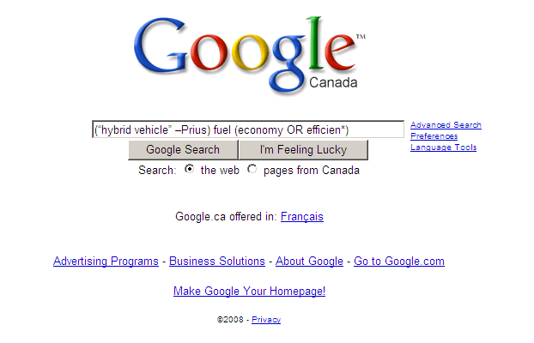
Form meaningful search phrases
using Boolean operators and wildcards
71
Notes:
71

Slide 72

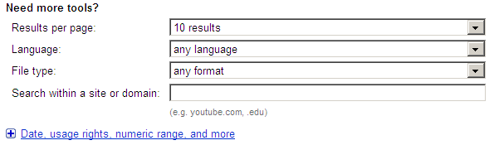
Advanced Google Search
72
Notes:
72

Slide 73
Advanced Google Search
Document type restriction
Ex. pricing type: pdf
Domain restriction:
.ca or .gc.ca
Putting emphasis on a term
Order: fuel efficient vs. efficient fuel
Repetition: hybrid hybrid vehicle
73
Notes:
73

Slide 74
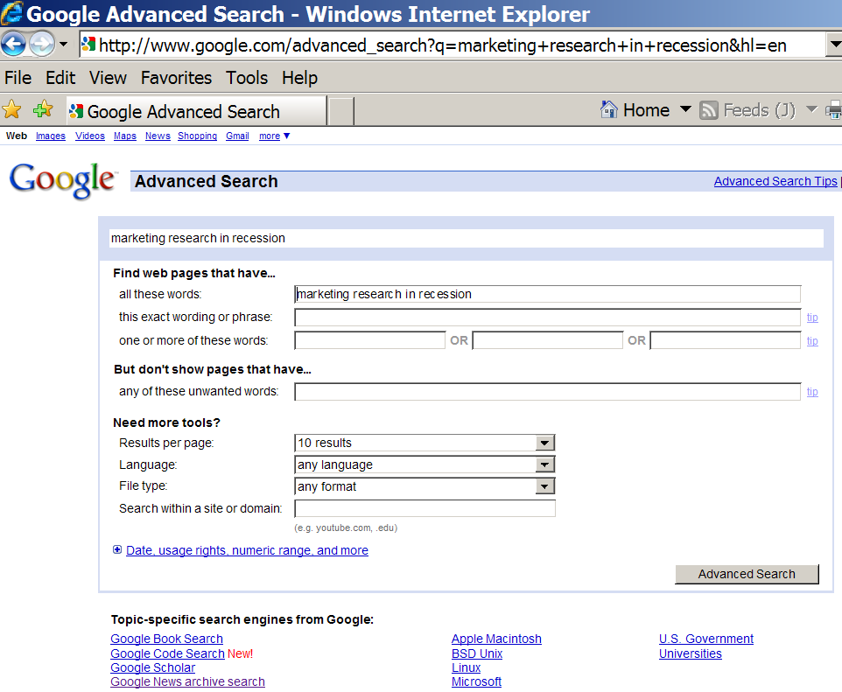
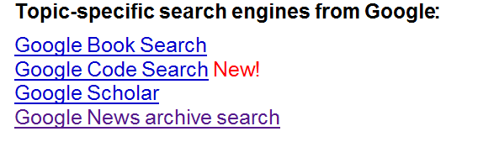
Topic Specific Search Engines in Google

Slide 75
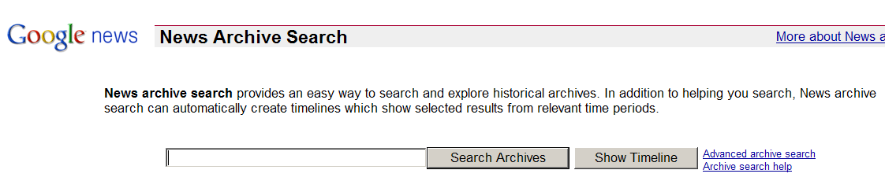
Google News Archive Search

Slide 76
Magazines/Periodicals to find relevant articles
Google Scholar: http://scholar.google.com
FindArticles.com: http://findarticles.com
MagPortal.com: http://magportal.com
HighWire: http://highwire.stanford.edu
Directory of Open Access Journals: http://www.doaj.org
Notes:
Google Scholar: http://scholar.google.com
search for article across the Web
FindArticles.com: http://findarticles.com
collection of full-text articles from 500+ publications
MagPortal.com: http://magportal.com
free service that helps you find individual magazine articles
HighWire: http://highwire.stanford.edu
scientific & medical journals from Stanford University
Dir of Open Access Journals: http://www.doaj.org
free, full text, quality controlled scientific and scholarly journals

Slide 77
Specialised Web Sources
Newspaper / Magazine Articles
Current and Up-to-date information.
Patents
Inventions from all over the world.
Subject Specific Web Directories
Science-related websites and information.

Slide 78
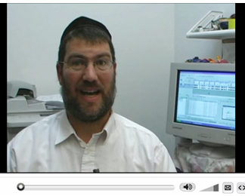
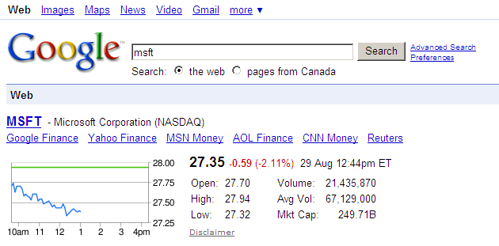
Financial Information
78
Notes:
78
Type in the call letters and you’ll get the most recent stock data. Also gives you the main financial sites.
Video: 1 min 40 sec.
http://www.expertvillage.com/video/40947_google-search-stock-quotes.htm [a whole range of the small videos on using Google]
Or find it at:
http://video.google.ca/videoplay?docid=1997534630669586272&ei=5yS4SOPtBZOKrgP25tjADA&q=how+to+search+google&vt=lf&hl=en

Slide 79
Images
Google Multimedia search http://images.google.com/
Altavista Multimedia search http://www.altavista.com/sites/search/simage
Clip Art Gallery http://office.microsoft.com/clipart
iStock Photo http://www.istockphoto.com/
Creative Commons http://creativecommons.org/

Slide 80
Search Tips…
Use more than one search engine.
Use lower case
Be specific when using keywords
Use synonyms and alternative terms.
Consider British & American spelling.
hybridisation, hybridization = hybrid*

Slide 81
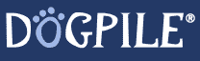
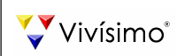

Meta Search Engines
Also known as metacrawlers
Concurrently searches many search engines
One-stop shopping search site
RECOMMENDED SITES:
1
2
3

Slide 82
Are you information literate?
Articulate an information need.
Locate relevant information sources.
Evaluate the quality of those sources.
Communicate the results of their research.

Slide 83
Evaluating Secondary Sources
What was the purpose of the study?
How was the information collected?
How consistent is the information with other information?
Who collected the information?
important

Slide 84
Who Collected the Information?
Authority:
Who is responsible for the data? What are the qualifications?
Accuracy:
Can facts presented be verified?
Objectivity:
Is the information presented in a “neutral tone?”
Currency:
Are dates (copyright or revision) on the web site or pages?
Content:
Does the source have “depth” ?
84

Slide 85
To Sum Up …
We looked at the 11 steps in the marketing research process.
The course will explore these in detail.
We start the first of three lectures covering secondary research.
Today, we focused on how to use search engines effectively.

Slide 86
A Final Thought
Marketing Research
may not be your chosen field
but …
Notes:
Tom - Don’t post this and the next slide on share out – just have them in your own lecture version.

Slide 87
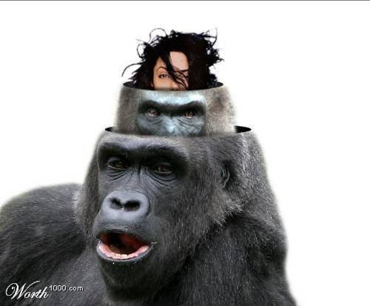
STAY OPEN-MINDED
Notes:
I at the beginning of the lecture I gave a small pep-talk why Marketing Research is an enormously important business tool.
For this slide I re-stated the message … If they can’t get excited about doing the research – surely they can get excited about what it can do for them! So let’s not stay in the dark ages … open your minds … and embrace this powerful field.

